Slide 1

Armed Forces College of Medicine
AFCM

Slide 2
Liver Cirrhosis & sequel 2
By
Dr. Yasser Omar
Dr Ahmed Elshafie
Revised by Mervat Behiry

Slide 3
Indented Learning Outcomes (ILOs)
By the end of this lecture you will be able to:
Find the key in the available patient data.
List differential diagnosis supported by the key in the available data
Select or interpret the investigations that will help you to support your most favourite diagnosis
Manage your case appropriately.
Apply scientific principles & knowledge to integrate these to solve patient case

Slide 4
CASE (1)
Mr Ahmed 50-year-old male with a long history of cirrhosis secondary to chronic hepatitis C is brought to the emergency department by his son with 2 days history of increasing confusion.
General examination: astrixes(ايده بترعش), marked jaundiced, blood pressure 100/60 mmHg, Pulse 89 pbm, temperature 38.8˚ C
Local ex.: moderate ascites.

Slide 5
Case 1 (cont.)
Laboratory results
- Albumin: 2.4 g/dl
- Total bilirubin: 8 mg/dl
- Creatinine: 1.1 mg/dl
- Urea: 15 mg/dl.
- RBS: 100 mg/dl.
- CBC:
Hemoglobin 9.9 g/dl
Platelet count 84,000 /Cmm
WBC: 13 × 10³ /Cmm

Slide 6
Case 1 (cont.)
Q1: What are the possible causes of patient altered conscious level?
Q2: What is the underlying mechanisms?
Q3: what is the clinical picture of the patient Condition?

Slide 7
Disturbed conscious level in CLD
In patient with CLD what is the most possible cause?
Hepatic encephalopathy
What are other possible causes?

Slide 8
Differential diagnosis of DCL in CLD
Hypoglycemia, ketoacidosis, hyperosmolar, lactate acidosis | Alcohol intoxication, withdrawal, Wernicke
Drugs: benzodiazepines, neuroleptics, opioids | Electrolyte disorders: hyponatremia and hypercalcemia (Diuretic overdose)
Uremic encephalopathy | Respiratory failure
Intracranial bleeding and stroke | Brain lesions: traumatic, neoplasms, normal pressure hydrocephalus
Non-convulsive epilepsy | Neuroinfections
Psychiatric disorders | Dementia

Slide 9
Patients with liver cell failure are prone to fasting hypoglycemia due to defective glycogen stores and impaired hepatic glucose output.
Exclusion of hypoglycemia should be done in LCF presented with Hepatic encephalopathy.
Ramadan fasting: Advanced liver disease patients are advised against fasting due to high risk of fasting hypoglycemia.

Slide 10
Patients with liver cell failure are prone to develop intracranial hemorrhage due to bleeding diathesis associated with LCF
Patients with LCF presented with altered conscious level should be evaluated for central cause (hemorrhage/infarction) if not improved after proper management.

Slide 11
Choose the Best Answer
What would you do immediately to Mr Ahmed in the ER ?
Random blood sugar
S. Ammonia level
EEG
CT scan
ABG

Slide 12
Hepatic encephalopathy (HE)
Definition:
It is a brain dysfunction caused by liver insufficiency and/or portosystemic shunting; it manifests as a wide spectrum of reversible neuropsychiatric syndromes ranging from subclinical alterations to coma after ruling out other causes for symptoms (structural, metabolic).

Slide 13
HE: Pathophysiology
Portosystemic shunts around hepatocytes and decreased hepatocellular functions → increased level of systemic toxins (believed to be ammonia from gut, mercaptans, fatty acids, amino acids) which go to the brain.

Slide 14
HE: Precipitating factors
Nitrogen load (GI bleeding, protein food intake).
Drugs (narcotics, CNS depressants, diuretics overdose).
Electrolyte disturbance: hypokalemia, alkalosis, hypoxia, hypovolemia.
Infection as spontaneous bacterial peritonitis.
Deteriorating liver function, superimposed liver disease.
- Precipitating factors should be specified.
- HE may be non-precipitated

Slide 15
HE: Clinical pictures
Symptoms:
Altered conscious level variable degree (alerted sleep rhythm up to deep coma) gradual onset progressive course
Slurred speech
Childish behavior
Previous attacks?
Precipitating factors?

Slide 16
HE: Clinical pictures
Signs:
Assessment of mental status: confusion, agitation, incoherent speech or sleeping most of the time.
Astrixis (flapping tremors)
Stigmata of liver cell failure

Slide 17
HE is subdivided according to the underlying disease
Type A | resulting from ALF
Type B | resulting predominantly from portosystemic bypass or shunting
Type C | resulting from cirrhosis

Slide 18
Question
His Family claimed 2-day history of increasing confusion, incoherent speech & sleeping most of the time. What is the stage of his presentation problem?
Stage I
Stage II
Stage III
Stage IV
Stage V

Slide 19
Hepatic encephalopathy stages
Covert | Minimal | Psychometric or neuropsychological alterations of tests exploring psychomotor speed/executive functions or neurophysiological alterations without clinical evidence of mental change.
 | Grade I | - Trivial lack of awareness - Euphoria or anxiety - Shortened attention span | • Impairment of addition or subtraction • Altered sleep rhythm
Overt | Grade II | Lethargy or apathy - Disorientation for time - Obvious personality change | - Inappropriate behaviour - Dyspraxia Asterixis
 | Grade III | - Somnolence to semi-stupor - Responsive to stimuli - Confused | - Gross disorientation - Bizarre behavior
 | Grade IV | Coma

Slide 20
HE: Investigations
Laboratories
- Glucose - Liver function tests - Renal function tests & Electrolytes - Cultures - Drug screening - Fasting Blood Ammonia level – not usually needed (the blood sample has be to collected without the use of a tourniquet and must be transported on ice to the laboratory to be analyzed within 20 minutes to ensure accuracy of the results)
Imaging
- CT, MRI - Chest radiograph to evaluate for infection or - Bowel abdominal imaging to evaluate for obstruction or ileus

Slide 21
Specific Approach to overt HE Treatment
A four-pronged approach to management of HE is recommended:
1- Initiation of care for patients with altered consciousness
2- Alternative causes of altered mental status should be sought and treated
3- Identification of precipitating factors and their correction
4- Commencement of empirical HE treatment

Slide 22
General lines of management
Coma: Airway protection, monitoring, maintain circulation & ICU admission.
Exclude alternative causes of DCL.
Identify & correct precipitating factors if present.
Nutritional support.

Slide 23
Empirical HE treatment
Non-absorbable Disaccharides (Lactulose):
- 25 mL of lactulose syrup every 12 hours until at least two soft or loose bowel movements per day are produced.
- Subsequently, the dosing is titrated to maintain two to three bowel movements per day.
- This dose reduction should be implemented.
- Overuse of lactulose → complications, such as diarrhea, dehydration, hypernatremia, aspiration, severe perianal skin irritation → precipitate HE

Slide 24
Empirical HE treatment
Non-absorbable Disaccharides (Lactulose):
- Colonic metabolism of lactulose to lactic acid results in acidification of the gut lumen →
1- Favours conversion of ammonia (NH₃) to ammonium (NH₄+) that is less absorbable.
2- Inhibits ammoniagenic coliform bacteria, leading to ↑levels of nonammoniagenic lactobacilli.
- Lactulose also works as a cathartic, reducing colonic bacterial load

Slide 25
Antibiotics
Rifaximin: non absorbable , remove ammonia producing bacteria from the gut.
Rifaximin is an effective add-on therapy to lactulose for prevention of OHE recurrence
Neomycin & metronidazole are an alternative choice for treatment of OHE

Slide 26
Other Therapies
Branched chain amino acids (BCAA)
L-ornithine L-aspartate (LOLA)
Probiotics.
Flumazenil.

Slide 27
The patient continued on medical treatment (anti coma measures and antibiotics)
On the third day of admission, the lab results revealed:
Albumin: 2.5 g/dl
Total bilirubin 7.5 mg/dl
RBS: 100 mg%.
Hemoglobin 9.5 g/dl
Platelet count 84,000 /Cmm
WBC: 9 × 10³ /Cmm
S. creatinine: 2 mg/dl urea 50 mg/dl
Q: Comment on these lab results ?

Slide 28
Question
What is the possible diagnosis of the patient condition?
1- renal failure
2- HRS II
3- Acute glomerulonephritis
4- pyelonephritis
5-HRS I

Slide 29
Diagnostic criteria of HRS
(1) Diagnosis of cirrhosis and ascites
(2) Diagnosis of AKI according to ICA-AKI criteria
(3) No response after 2 consecutive days of diuretic withdrawal and plasma volume expansion with albumin (1 g/kg of body weight)
(4) Absence of shock
(5) No current or recent use of nephrotoxic drugs (non-steroidal anti-inflammatory drugs, aminoglycosides, iodinated contrast media, etc.)
(6) No macroscopic signs of structural kidney injury, defined as absence of proteinuria (> 500 mg/d), absence of microhematuria (> 50 red blood cells per high power field) and normal findings on renal ultrasound

Slide 30
HRS types
Type 1 HRS(AKI): a rapid progressive renal impairment defined by doubling of the serum creatinine to a level > 2.5 mg/dL in less than two weeks.
Type 2 HRS(NAKI): a moderate renal impairment (serum creatinine > 1.5 and up to 2.5 mg/dL) with a steady progressive course that evolves over weeks to months

Slide 31
what are the possible triggering factors of this diagnosis?

Slide 32
Triggering factors of HRS
1- SBP
2- large volume paracentesis
3- GIT bleeding
4- Over-diuresis
5- NSAID

Slide 33
Triggering factors of HRS
1- SBP
2- large volume paracentesis
3- GIT bleeding
4- Ovrdiuresis
5- NSAID

Slide 34
What are the possible lines of management?
1- vasoconstrictor therapy: terlipressin, octreotide
2- albumin
3- midodrine
4- Liver transplantation
5- all of the above

Slide 35
Case (2)
A 60-year-old man with liver cirrhosis due to chronic hepatitis C presents with dyspnea. His oxygen saturation is 90% in the upright position, 98% in recumbence position. How would you confirm your diagnosis?

Slide 36
Non-contrast echocardiography
Air-contrast echocardiography
Dye-contrast echocardiography
Respiratory function tests
ABG

Slide 37
Hepato-pulmonary syndrome
Majority of cases due to liver cirrhosis but may be due to non cirrhotic portal hypertension
Mechanism: ventilation – perfusion mismatch, intrapulmonary shunt, limitation of oxygen diffusion, accumulation of vasodilator substances
c/p:
Hyperdynamic circulation
Dyspnea, platypnea (Dyspnea in upright position improve by recumbency)
Orthodeoxia: desaturation in upright position improve by recumbency

Slide 38
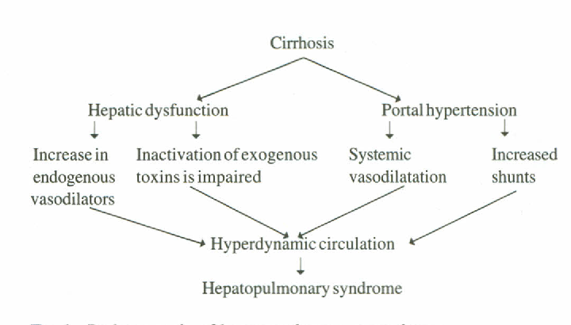

Slide 39
Hepato-pulmonary syndrome
Diagnosis: contrast enhanced echocardiography using agitated saline (air bubbles appear in the left ventricle after third beat )
Treatment: liver transplantation

Slide 40
Case (3)
A 55-year-old man with Hepatic focal lesion in abdominal US and α-fetoprotein of 150 U/ml. Which one of the following is not a risk factor for HCC?
Chronic Hepatitis B.
Chronic Hepatitis C.
Liver Cirrhosis.
Hemochromatosis.
Hepatitis A infection.

Slide 41
Hepatocellular carcinoma
Third leading cause of cancer death world wide
Risk factors:
Chronic Liver inflammation: HBV, HCV, hemochromatosis, alpha 1 antitrypsin def.
Medications (OCP), steroids.
Alcohol, smoking.
chemical carcinogens (aflatoxin).

Slide 42
Hepatocellular carcinoma
Clinical Picture
Right upper quadrant (RUQ) discomfort.
Sudden deterioration of stable liver patient.
Jaundice, weakness, weight loss and may be fever.
Hepatomegaly, bruit, hepatic friction rub.
Ascites with blood.
Paraneoplastic syndrome: hypoglycemia, hypercalcemia, erthrocytosis, watery diarrhea.
Metastasis: lung, bone, brain, peritoneal.

Slide 43
Hepatocellular carcinoma
Investigations:
Elevated ALP, AFP.
Deterioration of liver functions.
U/S (poorly defined margins and internal echos)
Triphasic CT (enhanced lesion in arterial phase and washed out in portal venous phase).
Dynamic MRI.

Slide 44
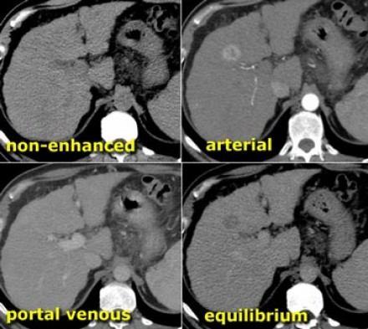
Tri-phasic CT Liver
No HFL in NECT. Filling of HCC in arterial phase. Disappearance of HCC in porto venous phase. Hypodense lesion in delayed equilibrium phase. Irregular outline denotes liver cirrhosis.

Slide 45
Hepatocellular carcinoma
Management
Surgical resection.
Liver transplantation:
Absolute contraindication: vascular invasion, extrahepatic disease.
Radiofrequency ablation, percutaneous ethanol injection, transcatheter arterial chemoembolization (TACE).
Sorafenib (oral chemotherapy): palliative
Radiotherapy.

Slide 46
How to manage patient with liver cirrhosis?

Slide 47
Management of cirrhosis
- Treatment of the cause:
Chronic viral hepatitis: antiviral drugs
Wilson disease: Dpenicillamine
Hemochromatosis: phlebotomy
- In established cirrhosis:
Treatment of complications
Screening for hepatocellular carcinoma (Abdominal U/S every 6 month ± αFP)
- Liver transplantation
- Maintenance of nutrition

Slide 48
How to assess prognosis of Cirrhotic patients?

Slide 49
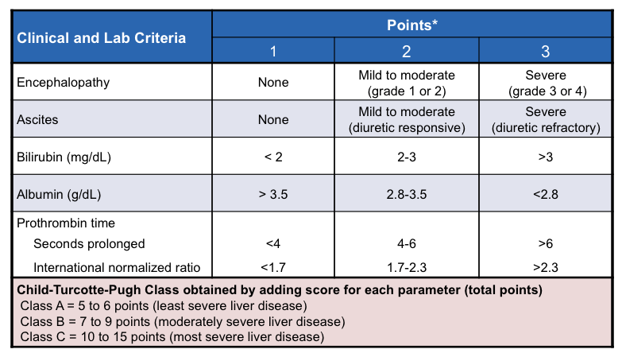
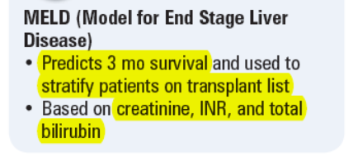
Child-Pugh score

Slide 50
Quizzes

Slide 51
Quiz 1
Increased level of the following systemic toxins are believed to be responsible except?
Ammonia from gut
Mercaptans
Fatty acids
Amino acids
Bilirubin

Slide 52
Quiz 2
All of the following could be responsible precipitating factors except?
GI bleed
Protein load from food intake
Constipation
Hypokalemia
Flumazenil (benzodiazepine receptor antagonist)

Slide 53
Quiz 3
A 48-year-old man with chronic hepatitis C virus infection, cirrhosis, and ascites presents with 2 days of confusion. He denies fever, chills, hematemesis, or melena. On physical examination, his temperature is 35.5° C, blood pressure 90/60, heart rate 100 beats per minute, respiratory rate 30/minute. He is confused and agitated, and asterixis is present. His abdomen has tense ascites but is nontender, and his stool is negative for blood. His laboratory tests include WBC 8.6, creatinine 2.1 (previously 0.8), and bilirubin 7.7 (previously 2.3). He is making only small amounts of urine, but his urinalysis is normal.

Slide 54
Quiz 3
Which of the following is the most appropriate test?
Diagnostic paracentesis and blood cultures
Large-volume paracentesis
Upper endoscopy
Brain CT
Renal ultrasound

Slide 55
Quiz 4
A 47-year-old man with liver cirrhosis & HCC. All of the following could be a typical presenting features except?
Hypocalcaemia
Ascites and intra-abdominal bleeding
Arterial bruit over the liver
Weight loss & RUQ discomfort
Brain metastasis

Slide 56
Quiz 5
A patient on your ward is suspected to have Hepatocellular carcinoma with Hepatic focal lesion on abdominal US. Which of the following is not correct regarding the diagnosis of Hepatocellular carcinoma (HCC)?
Normal α-fetoprotein does not exclude the diagnosis.
Liver biopsy is essential for diagnosis.
commonly diagnosed on the basis of imaging features alone
The diagnostic criteria on imaging is arterial phase hypervascularity (enhancement) and rapid portal phase wash-out.
Usually associated with deterioration in liver function.

Slide 57
Quiz 6
A 55-year-old man with child A liver cirrhosis due to chronic hepatitis C with single small HCC with no distant metastasis or vascular invasion. Curative treatment options include the following except:
Liver transplantation.
Surgical resection.
Radiofrequency ablation.
Sorafenib.

Slide 58
Take home message
Long term management of portal hypertension is essential to minimize the risk of progression of its complications.
Step-wise approach to manage ascites will prevent unnecessary and hazardous interventions.

Slide 59
References
EASL CPG decompensated cirrhosis. J Hepatol 2018;doi: 10.1016/j.jhep.2018.03.024
Goldman L, Schafer Al (Eds) (2020). Goldman-Cecil Medicine (26th ed.). Philadelphia, PA: Elsevier.
Fauci, AS, Kasper DL, Hauser SL, Longo DL, Loscalzo J (Eds.) (2018). Harrison's Principles of Internal Medicine (20th ed.). New York: McGraw-Hill Education.
Benjamin IJ, Griggs RC, Wing EJ, Fitz JG (Eds.) (2016). Andreoli and Carpenter’s Cecil Essentials of Medicine (9th ed.). Philadelphia, PA: Elsevier Saunders.

Slide 60
Thank You

